Slide 1
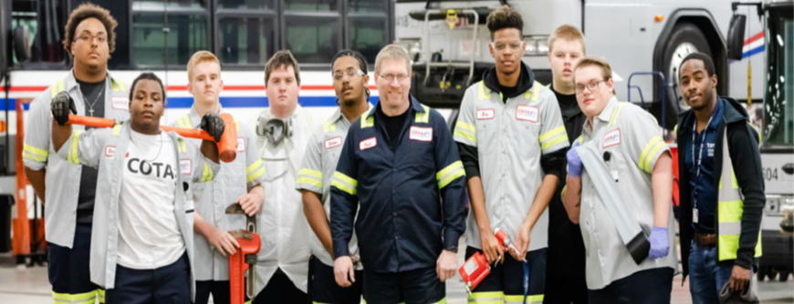


Partnerships that Work
Vehicle Maintenance Internship Program
Automotive Technology/Collision Career Technical Education

Slide 2

HISTORY
VEHICLE MAINTENANCE
INTERNSHIP PROGRAM
(Founded in 2017)
Commitment to Paying It Forward
The Central Ohio Transit Authority (COTA) Leadership along with TWU Local 208 and Columbus City Schools came to the table with intentions of forming a partnership that that would not only foster the education and interests of students enrolled in the automotive program at Fort Hayes Career Center but also prepare students to become productive members of society in their chosen career field, consequently, filling a pipeline of candidates currently lacking in the workforce.

Slide 3

FORT HAYES
CAREER CENTER MISSION
“To provide the career-related training and practical experiences that connect students to their dreams and future success.”

Slide 4

VISION
MOVE
TO
EVERY LIFE FORWARD

Slide 5
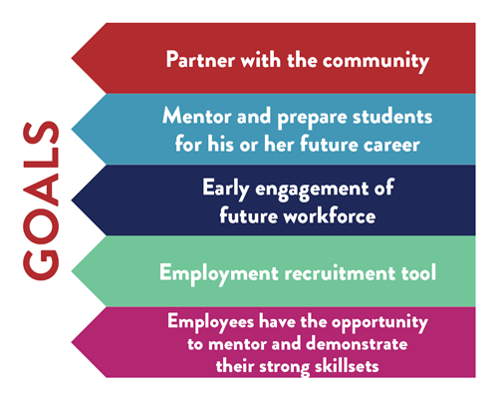
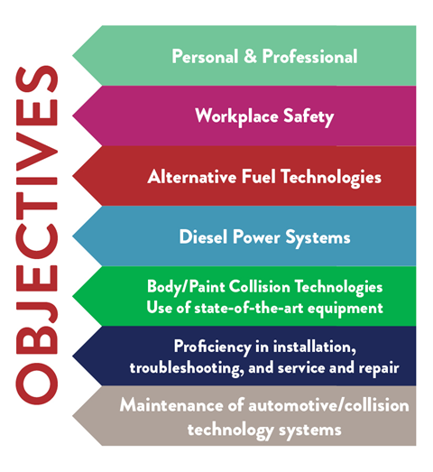
PROGRAM OVERVIEW
The COTA Vehicle Maintenance Internship Program’s intention is for Career Technical Center High School students who have completed their junior year in a participating Career-Technical program. Students who participate in the program will have the opportunity to work as paid interns in the Vehicle Maintenance Department at COTA. Students advance through a formal training program which consists of classroom trainings, hands-on training, laboratory experiences, and are partnered with mentors in preparation to enter the workforce as entry level automotive/collision technologies service technicians.

Slide 6

KEY PARTNER RESPONSIBILITIES
COLUMBUS CITY SCHOOLS
CAREER-TECHNICAL EDUCATION
CENTRALOHIO TRANSIT AUTHORITY
Provide student with a safe work environment.
Provide the school with attendance tracking by providing teachers with weekly attendance/progress reports.
Evaluate the performance of the student as it relates to the work at the job site and technologies and content standards.
Give the student sufficient orientation, training and supervision to help him/her become proficient and productive.
Provide the student with the same considerations given to other employees regarding safety, general working conditions and other regulations.
Follow all Federal and State of Ohio Child Labor Laws, which include OSHA Regulations.
Instructor Recommendation
No disciplinary issues
On track for graduation
93% attendance at school and on the job
Observe the student on the jobsite at least once a quarter and assist the company in evaluating the student and meet with the with intern program manager
Enforce the attendance and disciplinary regulations per the agreement
STUDENT & COLUMBUS CITY SCHOOLS

Slide 7
2017-2018
2018-2019
Hired 10 student interns (October –May)
Schedule: Mon-Thursday 12:00 - 5:00
$10 per hour/COTA buss pass
6 students hired as full-time vehicle maintenance employees (salary range $19 -$32 per hour)
Hired 10 student interns (October –May)
Schedule: Mon-Thursday 12:00 - 5:00
$10 per hour/COTA buss pass
4 students hired as full-time vehicle maintenance employees
SUCCESSES
2019-2020 New Model
2020-2021 Goals
Schedule: 1wk on 1wk off – 7:30am-2:30pm (students enroll in VCAP to fulfill required academics)
$12 per hour
Opportunity/Outcome: Apprenticeship Training Program, soft skills trainings, CDL opportunity, Career Readiness Seal assistance
Note: Under new model, students are completing their academic studies sooner with higher marks than their peers in other programs using the same model.
Program Expansion
Partner with other career technical schools who have automotive programs.
Offer opportunity to more students (gradually increase numbers)
Explore funding opportunities
Attract, train, and grow our own
workforce.

Slide 8
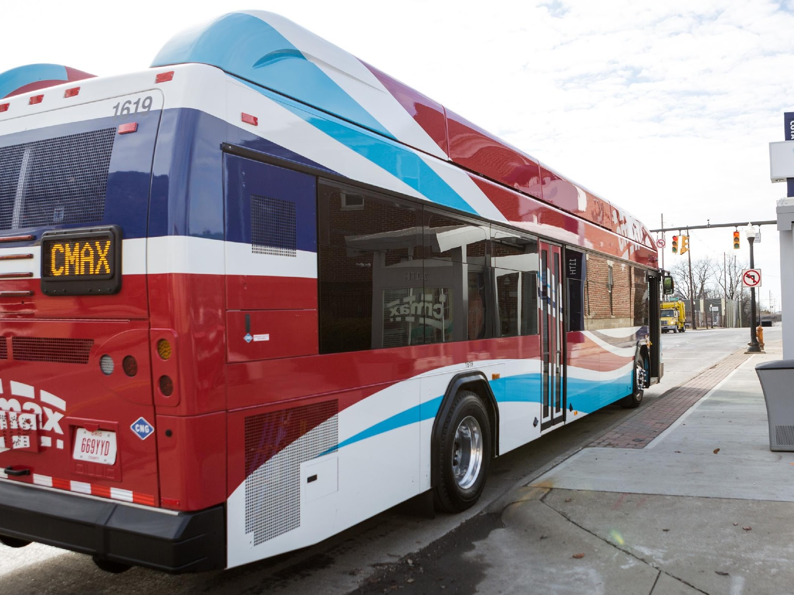

OUR MISSION
WE PROVIDE SOLUTIONS
that connect people to
PROSPERITY
THROUGH INNOVATION, DEDICATION AND TEAMWORK
QUESTIONS &
ANSWERS

